Slide 1
Bereavement Support
Liturgy - Intercessions

Slide 2
Prayers of the Faithful
Given here are sample Prayers of the Faithful you may wish to use as they are or to use as a template to compose your own. Feel free to use as many or as few as you wish.
The priest will introduce and conclude the prayers of intercession.
The first prayer is always for the deceased;
The last prayer is always for other deceased members of your family and the parish community.
The People’s Response to each intercession is: Lord, graciously hear us.

Slide 3
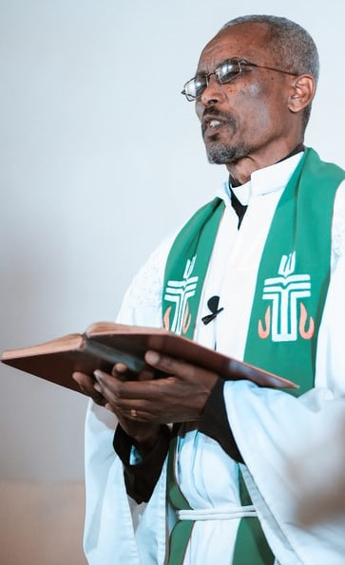
Priest’s Introduction to the Prayers of the Faithful:
For those who live a sincere and good life, the hour of death is transformed into an hour of glory, because Christ gives them the crown of eternal life. Let us pray in our hour of loss.
or
Christ is the Good Shepherd who gives his life to save those he loves. In our loss, let us turn to him and with confidence make our needs known to him.
or
We are made in the image and likeness of God. As trusting people, we pray to our merciful God.
or
God our Father has given us victory over sin and death through his Son, Jesus Christ. Let us turn to him in our hour of need and pray to him with confidence.

Slide 4
Prayers for the Deceased
In baptism, N. was given the pledge of eternal life. May he/she now be admitted to the company of the saints. Lord, hear us.
We pray for the gift of eternal life: That N. will be received into the Lord’s loving embrace. Lord, hear us.
For N.that Christ may have mercy on his/her soul, and grant him/her full pardon for his/her sins. Lord, hear us.
For N. who during his/her life received in faith the Body of Christ at the banquet of the altar. May he/she be raised up on the last day. Lord, hear us.
N. kept the faith; may he/she now receive from Christ the crown of eternal glory which He won for us with His death and resurrection. Lord, hear us.
That the hardships and sufferings N. endured in this life may gain for him/her full remission of all his/her sins. Lord, hear us.
We pray for N. that God will reward him/her with peace and joy for the good he/she did during his/her life. Lord, hear us.
N. has finally reached the shore of eternity; now that all his/her earthly tasks are completed, may he/she enjoy rest from all his/her labours. Lord, hear us.

Slide 5
Prayers for family, carers, community
For N.’s family, that in these difficult and dark days they may be sustained by their faith, and by the knowledge that they will be reunited with N. one day in God’s heavenly Kingdom. Lord, hear us.
That God may visit N.’s family and friends with comfort and peace especially his/her neighbours and those who cared for him/her. Lord, hear us.
That those who grieve over the loss of N., may all be comforted by the knowledge that the Lord will take care of him/her. Lord, hear us.
For those who grieve over his/her death; that through their faith in Christ their sorrow may soon be changed into joy. Lord, hear us.
We pray for N.’s family and friends who shared a long life with him/her and looked after him/her. That God may now strengthen them, through their love for each other and their faith. Lord, hear us.
We pray for all nurses and carers, particularly the nurses and carers who were so good to N. in the last months of his/her life. Lord, hear us.
For all who knew and loved N.: that they may draw inspiration from his/her life. Lord, hear us.

Slide 6
Prayers of General Intercession
The gift of life, which we all share, is very precious. Lord, make us more aware of the gifts and talents you have given us, particularly those that we so often take for granted. May we use them to make the world a better place. Lord, hear us.
For all of us gathered here: that we may remember at all times, but especially at times of trouble and anxiety, that we are loved by God and that he will take care of us. Lord, hear us.
For all who are sick. May the Lord fill them with courage and give them strength. Lord, hear us.
We pray for all gathered here today: that we may keep our minds and hearts on the kingdom that lasts forever. Lord, hear us.
For those who are without faith: that Christ may open their ears and hearts to receive the Good News of salvation. Lord, hear us.

Slide 7
Prayers for deceased members of our family and of the parish community (you may wish to mention specific family members today)
For our deceased relatives and friends: that God may bring them into the light of his presence, and give them a share in his glory. Lord, hear us.
For all the faithful departed: that they may see God face to face in the kingdom of heaven. Lord, hear us.
For all the faithful departed, especially our relatives and friends and members of this community; that they may dwell in the house of the Lord forever. Lord, hear us.
Many friends and members of our families have gone before us and await the Kingdom. Grant them an everlasting home with your Son. Lord, hear us.

Slide 8
Priest’s Conclusion to the Prayers of the Faithful:
Father, into your hands we commend the soul of our brother/sister N. Look gently upon him/her and bring him/her home to your kingdom where death will be no more. We ask this through Christ our Lord. Amen.
or
Eternal God, as Saint Augustine taught us, you have made us for yourself alone, and our hearts are restless until they rest in you. Secure in this knowledge, we ask you to grant these prayers, through Jesus who is Lord for ever and ever. Amen.
or
Lord, give us the certainty that beyond death there is a life where broken things are mended and lost things are found; where there is rest for the weary and joy for the sad; where all that we have loved and willed of good exists, and where we will meet again our loved ones. We ask this through Christ our Lord. Amen
or
Lord, may you support us all day long, till the shadows lengthen and evening falls and the busy world is hushed and the fever of life is over, and our work is done; then in your mercy, Lord, grant us a safe lodging, a holy rest and peace at the last. We ask this through Christ our Lord. Amen.

