Slide 1
Stations of the Cross
Art by Laura James

Slide 2
The First Station Jesus is Condemned to Death
Leader: We adore you, O Christ, and we praise you.
All: Because by your holy cross you have redeemed the world.

Slide 3
The First Station Jesus is condemned to death
I love you, Jesus, my love above all things. I repent with my whole heart for having offended you. Never permit me to separate myself from you again. Grant that I may love you always, and then do with me what you will.

Slide 4
The Second Station Jesus takes up his cross
Leader: We adore you, O Christ, and we praise you.
All: Because by your holy cross you have redeemed the world.

Slide 5
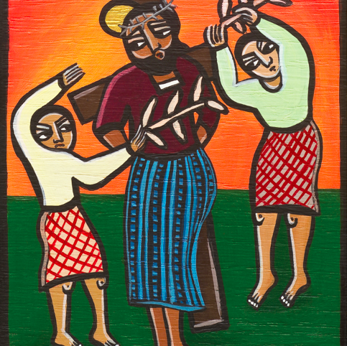
The Second Station Jesus takes up his cross
I love you, Jesus, my love above all things. I repent with my whole heart for having offended you. Never permit me to separate myself from you again. Grant that I may love you always, and then do with me what you will.

Slide 6
The Third Station Jesus falls for the first time
Leader: We adore you, O Christ, and we praise you.
All: Because by your holy cross you have redeemed the world.

Slide 7
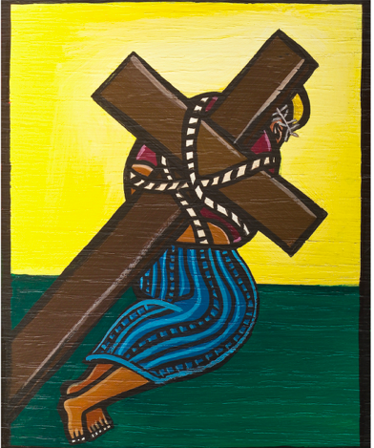
The Third Station Jesus falls for the first time
I love you, Jesus, my love above all things. I repent with my whole heart for having offended you. Never permit me to separate myself from you again. Grant that I may love you always, and then do with me what you will.

Slide 8
The Fourth Station Jesus meets his mother
Leader: We adore you, O Christ, and we praise you.
All: Because by your holy cross you have redeemed the world.

Slide 9
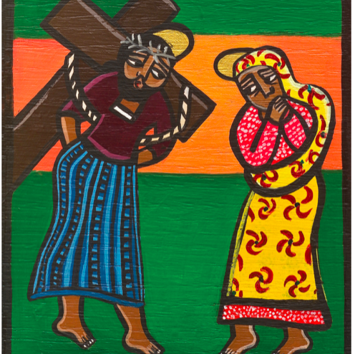
The Fourth Station Jesus meets his mother
I love you, Jesus, my love above all things. I repent with my whole heart for having offended you. Never permit me to separate myself from you again. Grant that I may love you always, and then do with me what you will.

Slide 10
The Fifth Station Simon helps Jesus carry His cross
Leader: We adore you, O Christ, and we praise you.
All: Because by your holy cross you have redeemed the world.

Slide 11
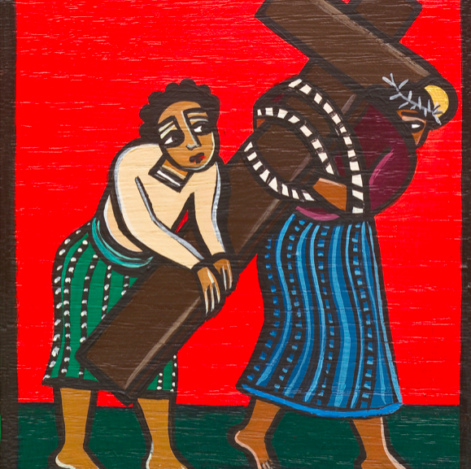
The Fifth Station Simon helps Jesus carry His cross
I love you, Jesus, my love above all things. I repent with my whole heart for having offended you. Never permit me to separate myself from you again. Grant that I may love you always, and then do with me what you will.

Slide 12
The Sixth Station Veronica wipes the face of Jesus
Leader: We adore you, O Christ, and we praise you.
All: Because by your holy cross you have redeemed the world.

Slide 13
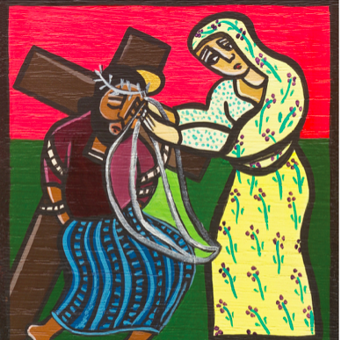
The Sixth Station Veronica wipes the face of Jesus
I love you, Jesus, my love above all things. I repent with my whole heart for having offended you. Never permit me to separate myself from you again. Grant that I may love you always, and then do with me what you will.

Slide 14
The Seventh Station Jesus falls for the second time
Leader: We adore you, O Christ, and we praise you.
All: Because by your holy cross you have redeemed the world.

Slide 15
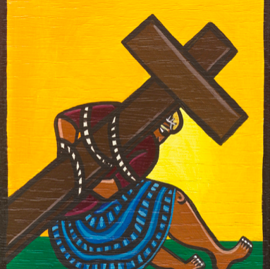
The Seventh Station Jesus falls for the second time
I love you, Jesus, my love above all things. I repent with my whole heart for having offended you. Never permit me to separate myself from you again. Grant that I may love you always, and then do with me what you will.

Slide 16
The Eighth Station Jesus meets the women of Jerusalem
Leader: We adore you, O Christ, and we praise you.
All: Because by your holy cross you have redeemed the world.

Slide 17
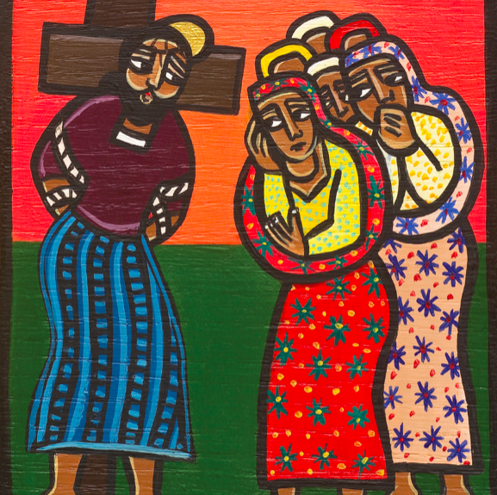
The Eighth Station Jesus meets the women of Jerusalem
I love you, Jesus, my love above all things. I repent with my whole heart for having offended you. Never permit me to separate myself from you again. Grant that I may love you always, and then do with me what you will.

Slide 18
The Ninth Station Jesus falls for the third time
Leader: We adore you, O Christ, and we praise you.
All: Because by your holy cross you have redeemed the world.

Slide 19
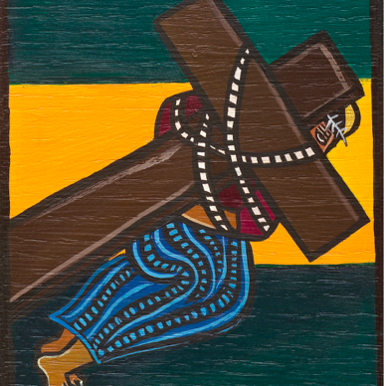
The Ninth Station Jesus falls for the third time
I love you, Jesus, my love above all things. I repent with my whole heart for having offended you. Never permit me to separate myself from you again. Grant that I may love you always, and then do with me what you will.

Slide 20
The Tenth Station Jesus is stripped of his clothing
Leader: We adore you, O Christ, and we praise you.
All: Because by your holy cross you have redeemed the world.

Slide 21
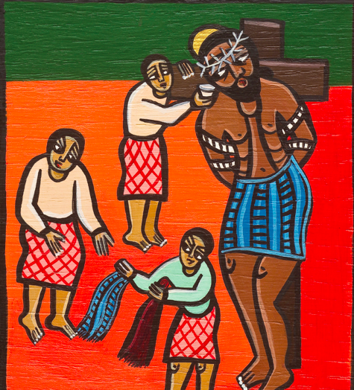
The Tenth Station Jesus is stripped of his clothing
I love you, Jesus, my love above all things. I repent with my whole heart for having offended you. Never permit me to separate myself from you again. Grant that I may love you always, and then do with me what you will.

Slide 22
The Eleventh Station Jesus is nailed to the cross
Leader: We adore you, O Christ, and we praise you.
All: Because by your holy cross you have redeemed the world.

Slide 23
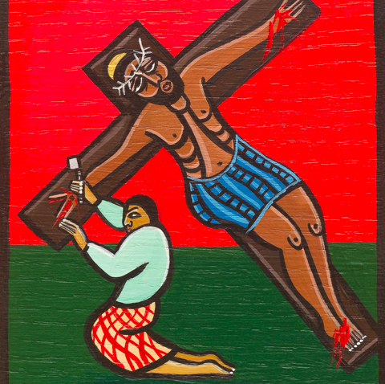
The Eleventh Station Jesus is nailed to the cross
I love you, Jesus, my love above all things. I repent with my whole heart for having offended you. Never permit me to separate myself from you again. Grant that I may love you always, and then do with me what you will.

Slide 24
The Twelfth Station Jesus dies on the cross
Leader: We adore you, O Christ, and we praise you.
All: Because by your holy cross you have redeemed the world.

Slide 25
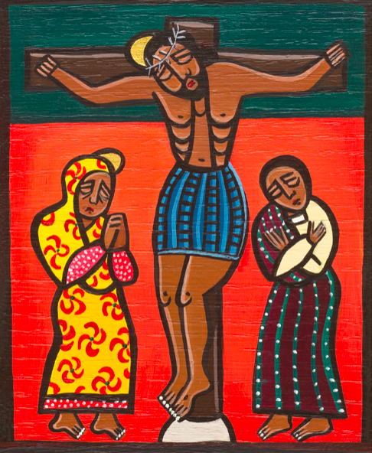
The Twelfth Station Jesus dies on the cross
I love you, Jesus, my love above all things. I repent with my whole heart for having offended you. Never permit me to separate myself from you again. Grant that I may love you always, and then do with me what you will.

Slide 26
The Thirteenth Station Jesus is taken down from the cross
Leader: We adore you, O Christ, and we praise you.
All: Because by your holy cross you have redeemed the world.

Slide 27
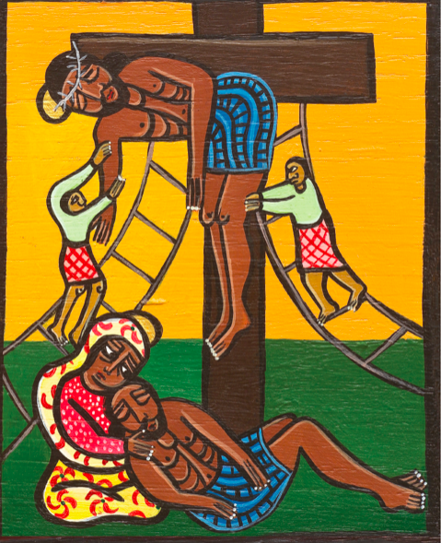
The Thirteenth Station Jesus is taken down from the cross
I love you, Jesus, my love above all things. I repent with my whole heart for having offended you. Never permit me to separate myself from you again. Grant that I may love you always, and then do with me what you will.

Slide 28
The Fourteenth Station Jesus is laid in the tomb
Leader: We adore you, O Christ, and we praise you.
All: Because by your holy cross you have redeemed the world.

Slide 29
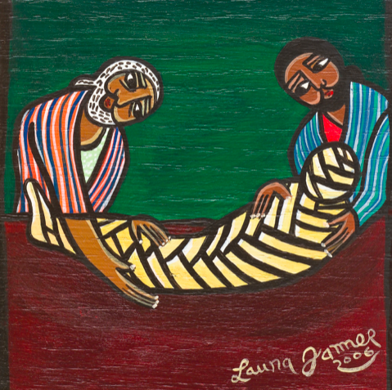
The Fourteenth Station Jesus is laid in the tomb
I love you, Jesus, my love above all things. I repent with my whole heart for having offended you. Never permit me to separate myself from you again. Grant that I may love you always, and then do with me what you will.

